Slide 1
Migration Training- Day 2

Slide 2
Agenda
What is Database Migration
DB Assessment
Database Migration
Types of DB Migration
Post-Migration Checks & Validation
File Systems Migration.
Database Version Upgrade

Slide 3
What is Database Migration

Slide 4
Database Migration
Database migration involves moving data from one database environment to another. This can include transferring between different types of database systems or upgrading to a newer version of the same system.
The goal is to ensure a smooth transition with minimal downtime and to maintain data integrity and system performance throughout the process.
Key steps include planning, executing the migration, and validating the results to ensure that the data has been accurately transferred and the new environment is functioning correctly.

Slide 5
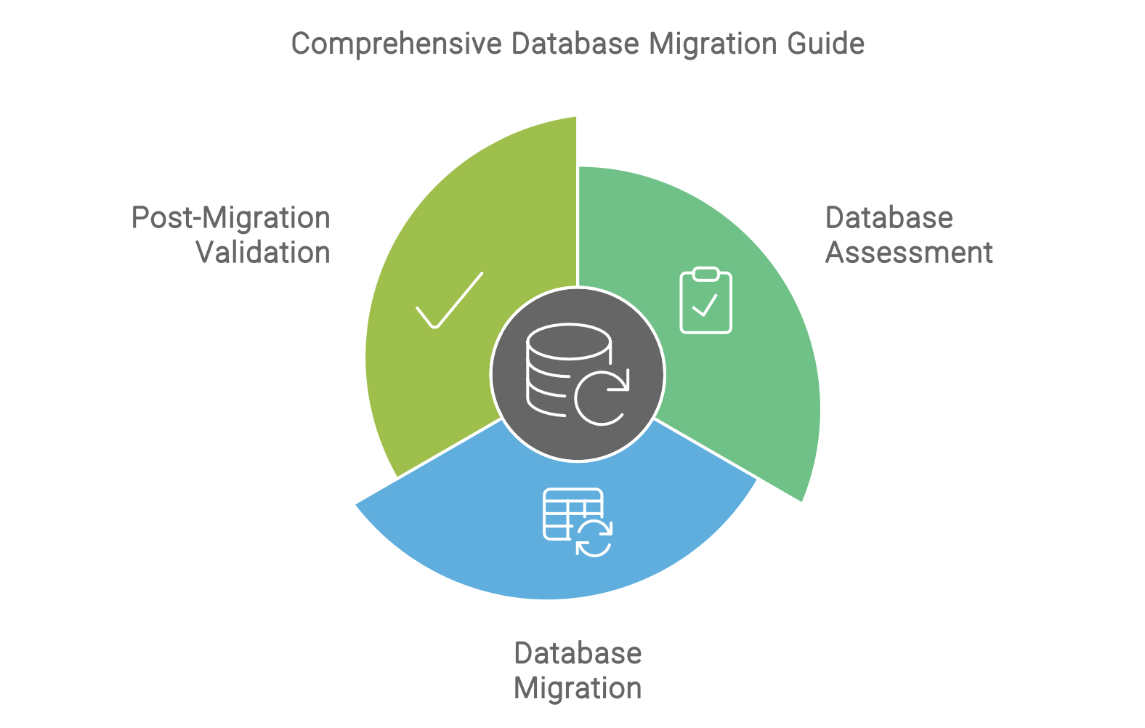
DB Migration Involves

Slide 6
Database Assessment

Slide 7
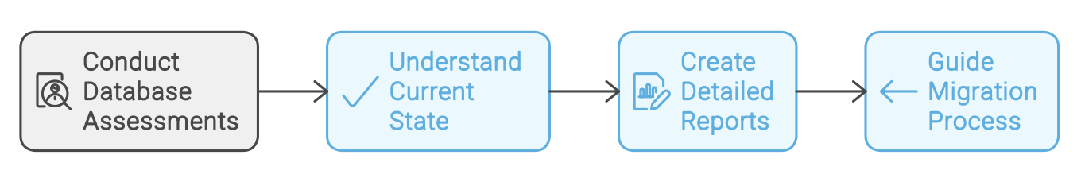
DB Assessment
Assessing your database involves evaluating its current state to identify potential issues and plan for a smooth migration. This includes understanding the database structure, performance, and dependencies to ensure compatibility with the target environment and to address any risks before starting the migration.

Slide 8
Steps
Initial Assessment:
- Inventory: List all databases, their versions, and dependencies.
- Compatibility Check: Identify potential issues with the target environment.
Database Health Check "
- Performance Analysis: Using metrics such as query execution time, index usage, and transaction logs.
- Storage Analysis: Assess storage usage, growth patterns, and future requirements.
Reporting:
- Summary Report: Create a report summarizing the assessment findings.
- Risk Analysis: Identify and document any risks associated with the migration.

Slide 9
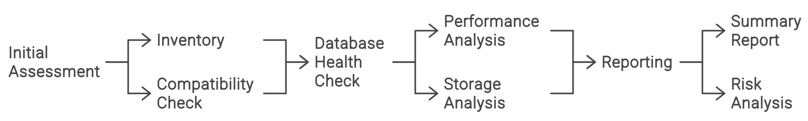
Flow Diagram

Slide 10
Tools for DB Assessment
Cloud-Native Assessment Tools:
Azure Migrate: Database Assessment
AWS Schema Conversion Tool (SCT)
Google Database Migration Service (DMS)
Azure SQL Database Migration Extension
Oracle Cloud Infrastructure (OCI) Database Migration Assessment
Third-party tools for DB assessment. Some of these include DBmaestro, Redgate SQL Toolbelt, Datometry, Flexera.

Slide 11
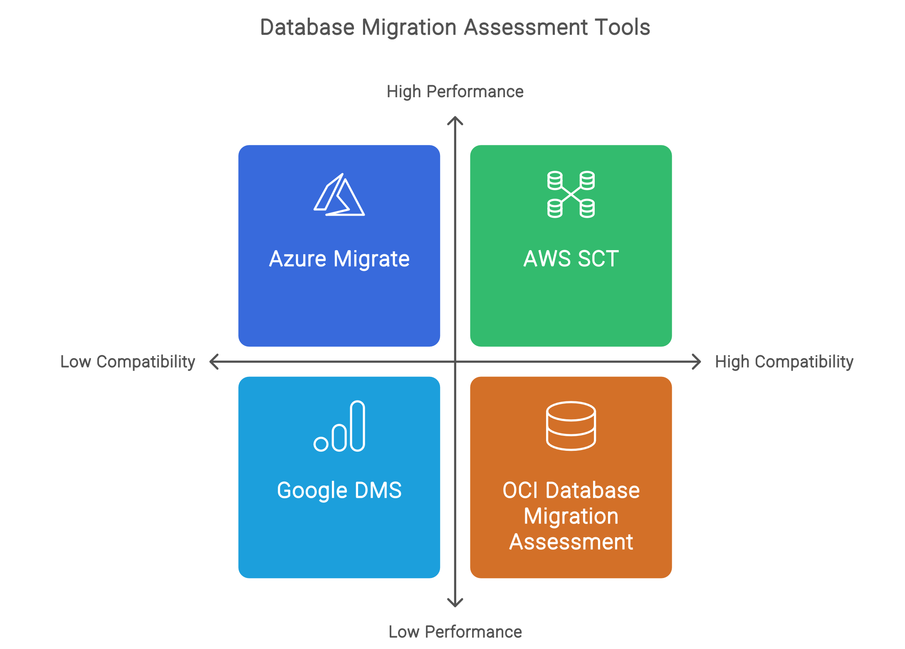
Tools

Slide 12
Database Migration

Slide 13
DB Migration Process
Pre-Migration Planning
- Backup: Ensure a complete backup of the database is taken.
- Compatibility Check: Confirm that the target environment supports all features of the database.
Migration Execution - Initial Data Transfer: Use the chosen tool to migrate the data. Monitor for errors.
- Validation: Check data integrity post-migration to ensure no data loss or corruption.
Cutover - Final Sync: Sync any remaining data changes from the source to the target.
- Switch Over: Redirect application traffic to the new database server.

Slide 14
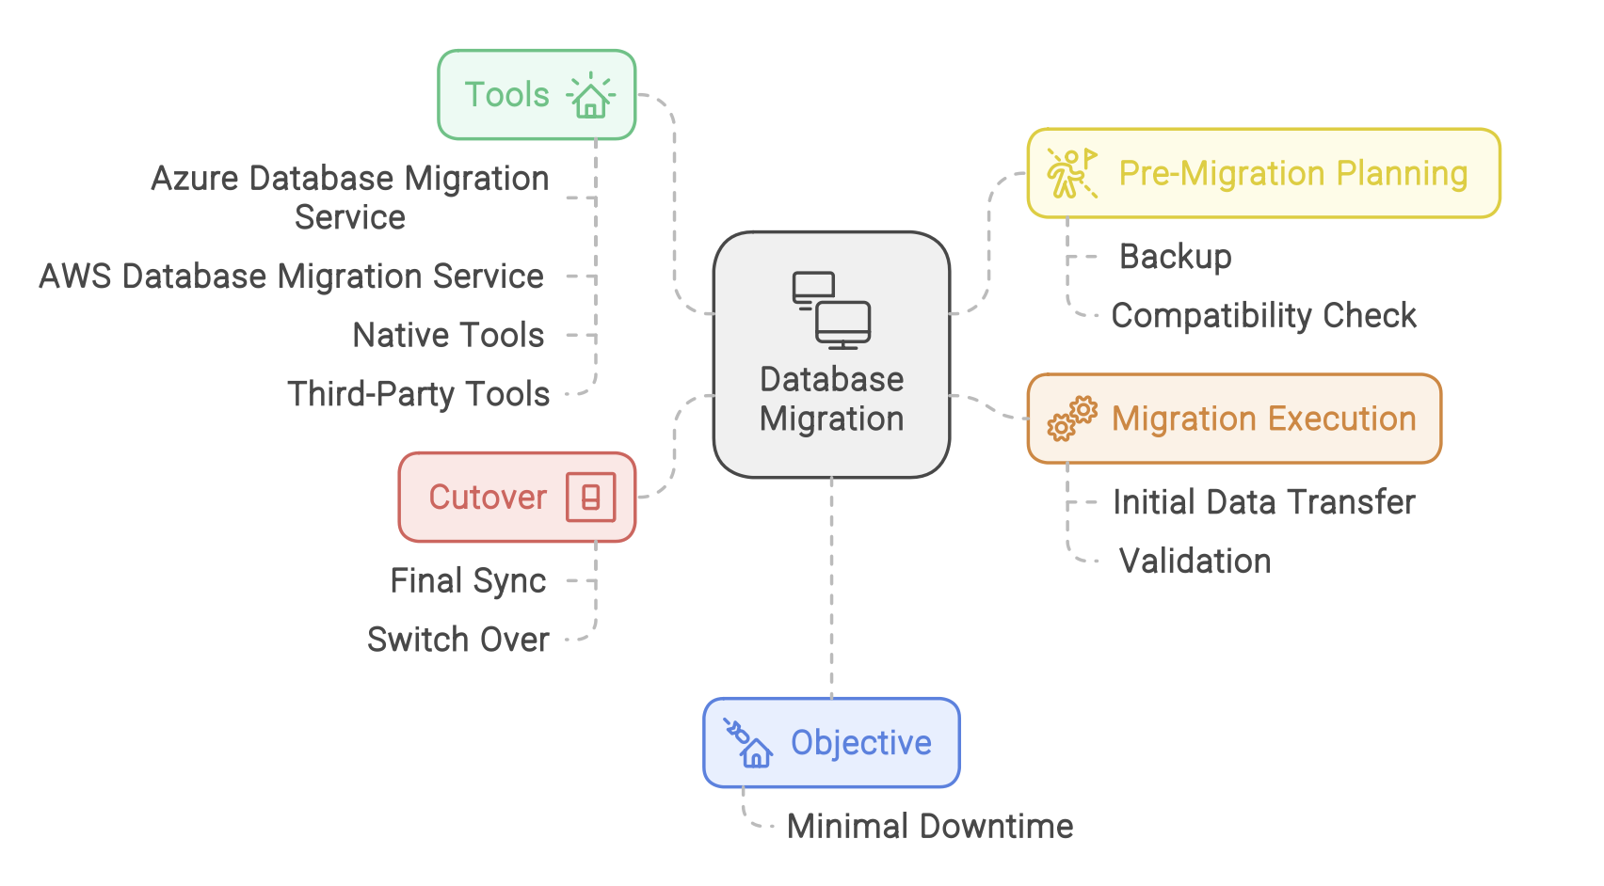
Flow Diagram

Slide 15
Tools for DB Migration
Azure Database Migration Service
AWS Database Migration Service
Native Tools (e.g., mysqldump for MySQL, pg_dump for PostgreSQL)
Third-Party Tools (e.g., Redgate, DBmaestro)
Example
Scenario: Migrating a MySQL database from an on-premises server to AWS RDS.
Action: Use AWS Database Migration Service to migrate the database with continuous
replication to minimize downtime.

Slide 16
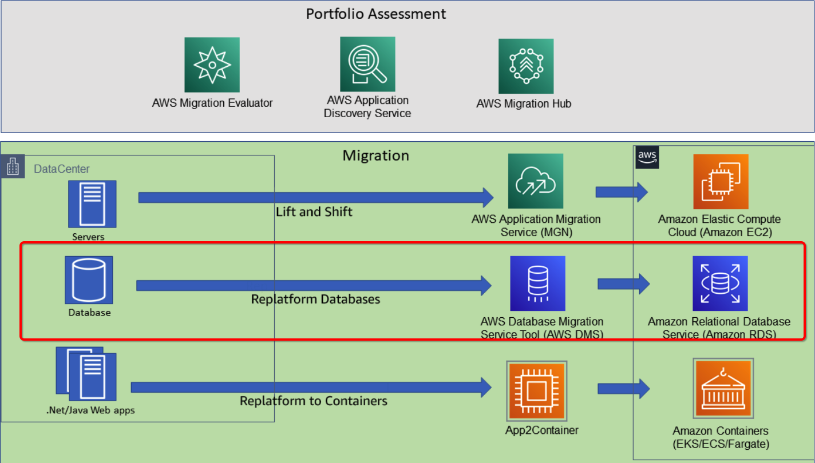
Migration to AWS

Slide 17
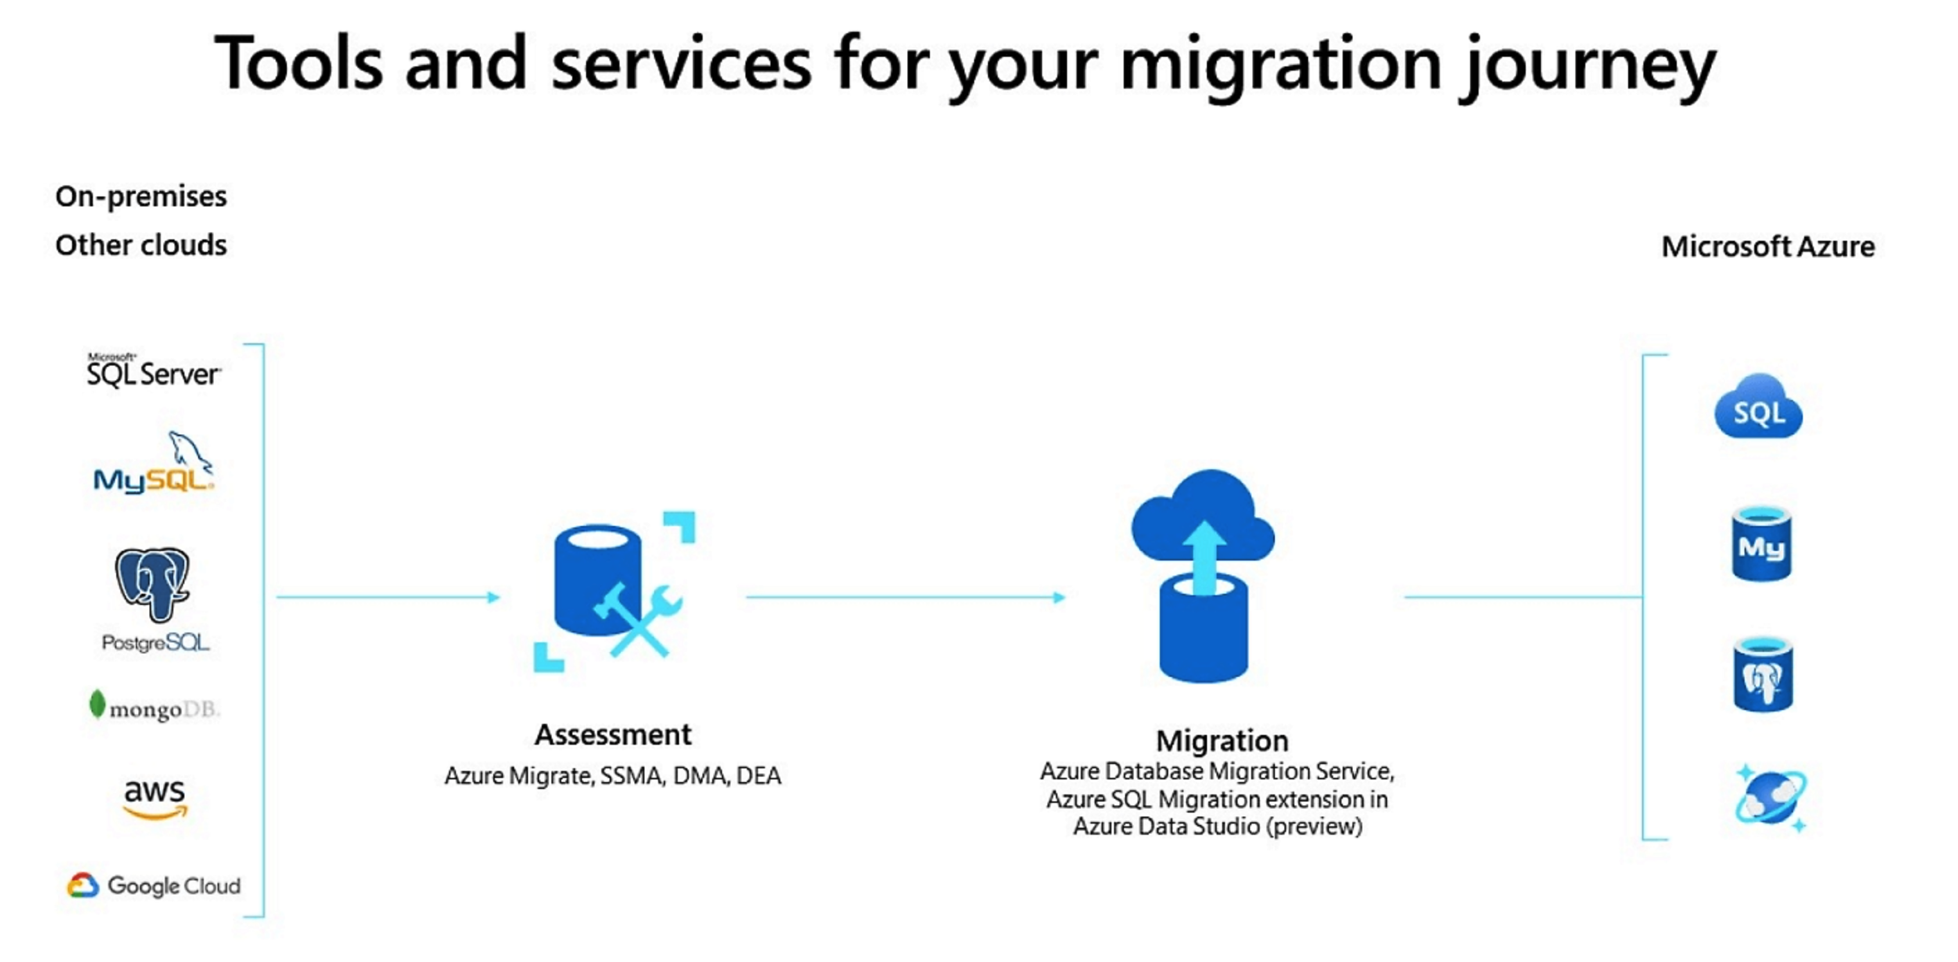
Migration to Azure

Slide 18
Demo

Slide 19
DB Migration Types

Slide 20
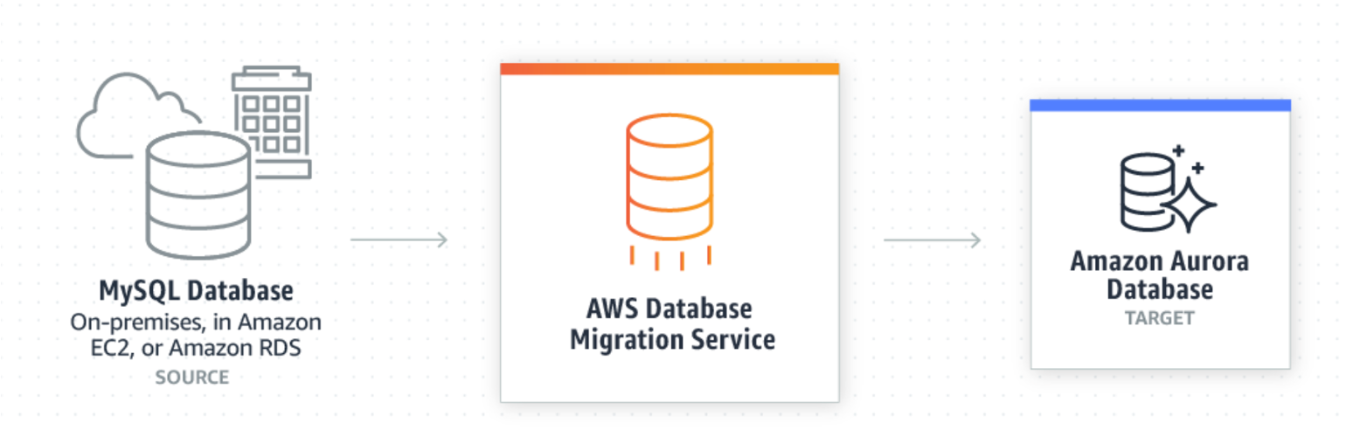
DB Migration Types
Homogeneous DB Migration
Both the source and target databases are of the same type, making the migration straightforward.
This process is generally simpler since the database structures and features are consistent.
Example:
Migrating from Oracle Database to another Oracle Database.

Slide 21
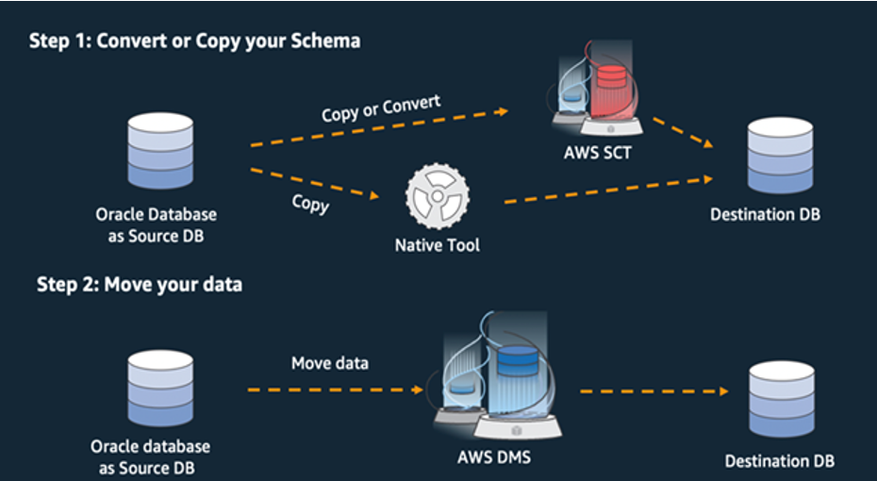
DB Migration Types
2. Heterogeneous DB Migration
Source and target databases are different, requiring
data transformation and conversion. This migration is
more complex due to differences in data structures and
database features.
Example:
Migrating from Microsoft SQL Server to MySQL.

Slide 22
Post-Migration Validation & Reporting

Slide 23
Post Migration Validation & Reporting
Validation:
Ensure that the migration was successful, and that the database operates as expected. Post-migration
validation checks data integrity, performance, and application functionality.
Reporting:
Document the migration process, highlighting any issues encountered, and confirm that the database
meets all operational requirements.

Slide 24
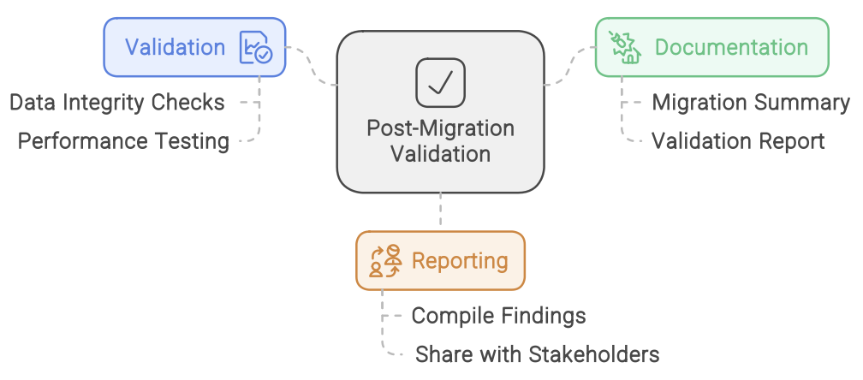
Post Migration Validation & Reporting

Slide 25
Post Migration Validation Process
Post-Migration Validation
- Data Integrity Checks: Compare row counts, checksum values, and other metrics between the source and target databases.
- Performance Testing: Ensure that queries and transactions are performing at or better than pre-migration levels.
Documentation
- Migration Summary: Document the migration steps, challenges encountered, and resolutions.
- Validation Report: Include results from integrity and performance tests.
Final Reporting
- Report Compilation: Compile all findings, validations, and performance metrics into a comprehensive
report to be shared with stakeholders.

Slide 26
File System Migration

Slide 27

File System Migration Process
Pre-Migration Preparation - File Inventory: Catalog all files and directories to be migrated.
- Data Classification: Identify critical files that require special handling or encryption.
Migration Execution - Initial Copy: Use Robocopy or rsync to transfer files to the target environment.
- Data Validation: Verify that all files were transferred correctly using checksums.

Slide 28
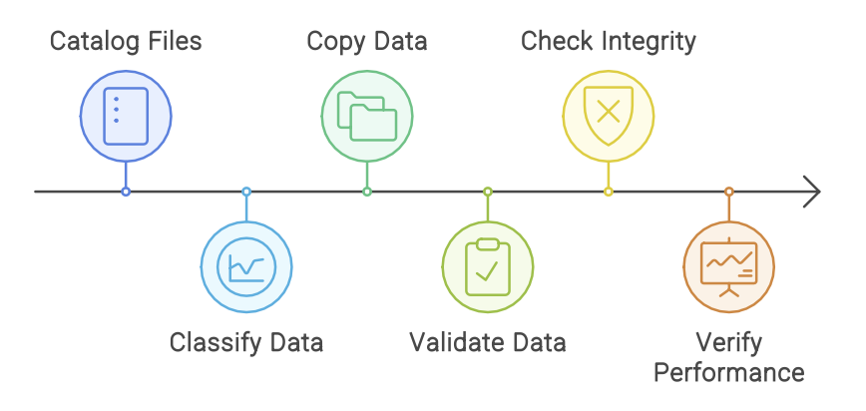
File System Migration Process
Post-Migration Validation
- Data Integrity Check: Ensure files are not corrupted during the transfer.
- Performance Validation: Ensure that access times and file operations meet expected performance levels.

Slide 29
File System Migration
Example
Scenario: Migrating large datasets from an on-premises file server to Azure Blob Storage.
Action: Use Azure Data Factory to orchestrate the migration and ensure data integrity
by comparing file checksums before and after migration.

Slide 30
Database Version Upgrade

Slide 31
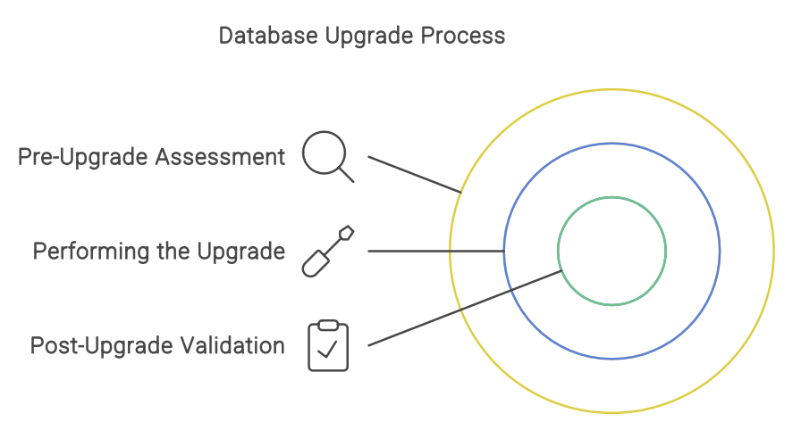
DB Version Upgrade
Objective: Upgrade the database version while ensuring compatibility and minimal impact on operations.

Slide 32
DB Migration Process
Pre-Upgrade Assessment
- Backup: Take a full backup of the database before starting the upgrade.
- Compatibility Check: Use tools like SQL Server Upgrade Advisor or Data Migration
Assistant to check for deprecated features or breaking changes.
Performing the Upgrade - Upgrade Execution: Run the upgrade using the appropriate tool for the database.
- Monitoring: Keep a close watch on logs and performance metrics during the upgrade.
Post-Upgrade Validation - Testing Queries: Run key queries to ensure they function as expected post-upgrade.
- Application Testing: Ensure that all applications interfacing with the database are fully functional.

Slide 33
Tools For DB Version Upgrade
SQL Server Upgrade Advisor - Outdated
Data Migration Assistant - The Data Migration Assistant (DMA) helps you upgrade to a
modern data platform by detecting compatibility issues that can affect database functionality when you:
• Upgrade to a new version of SQL Server
• Migrate to Azure SQL Database
• Migrate to Azure SQL Managed Instance
DMA recommends performance and reliability improvements for your target environment and allows you to move your schema, data, and uncontained objects from your source server to your target server.
pg_upgrade (PostgreSQL)

Slide 34
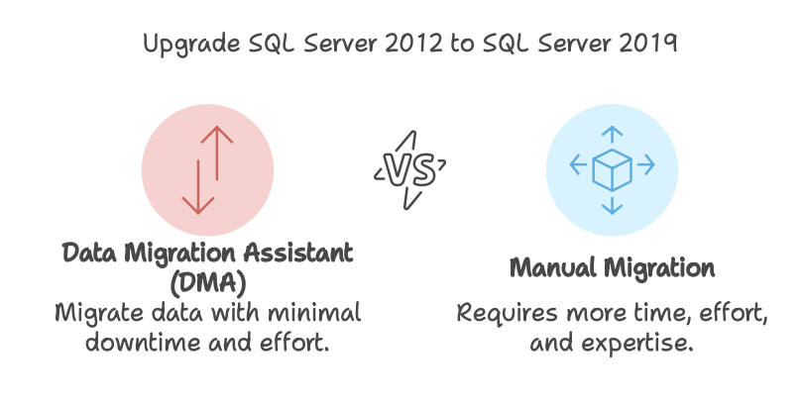
DB Version Upgrade – Use case
Scenario: Upgrading a SQL Server 2012 database to SQL Server 2019 using Data
Migration Assistant.

Slide 35
DB Version Upgrade – Use case
Supported Sources
- SQL Server 2005 (deprecated)
- SQL Server 2008
- SQL Server 2008 R2 - SQL Server 2012
- SQL Server 2014 - SQL Server 2016 - SQL Server 2017 - SQL Server 2019 - SQL Server 2022 - Amazon RDS for SQL Server
Supported Targets
- SQL Server 2012
- SQL Server 2014
- SQL Server 2016
- SQL Server 2017 on Windows and Linux
- SQL Server 2019 on Windows and Linux
- SQL Server 2022 on Windows and Linux
- Azure SQL Database
- Azure SQL Managed Instance(assessment only)
- SQL Server on Azure VMs

Slide 36
Demo

Slide 37
Task

Slide 38
Task
1. Develop and execute a solution to migrate the data from an Excel file into an Azure SQL Server database with the help of Azure Data Factory (ADF) and Azure Storage Account. Please migrate only the mentioned columns, with the correct data type.
2. What does Azure Migrate do? Perform a hands-on database assessment using Azure Migrate and migrate databases from a VM to a SQL Managed Instance.

Slide 39
Q & A

Slide 40
Thank You

